Slide 1
Incident Business Updates 2022 Elka Erikson elka.erikson@usda.gov Savanha Bechdolt savanha.bechdolt@usda.gov
Notes:
Elka and Savanha

Slide 2
Updates
Incident Business Organization
Chiefs Letter
COVID-19
Work/Rest
Travel/Lodging Guidance Waiver 2022
ASC Updates
AIMS
Incident Procurement/BUYING TEAM
FIRENET and Records Management

Slide 3
2022 Chief’s Letter Highlights
Health, Safety and well being of the fire management community and the public we serve.
Covid-19 mitigations
Well-being of employees- 2022 Red Book update reflecting three days off rest for every 14 days worked, excluding travel days, upon return to home unit.
Multiple suppression strategies this year we will more clearly articulate how and when we specifically use fire for resource benefit. The Red Book will be updated to require that during National and/or Regional Preparedness Levels 4 and 5, when difficult trade-off decisions must be made in how to deploy scarce resources most effectively, Regional Forester approval will be required to use this fire management strategy.
Notes:
Elka

Slide 4
COVID-19
Testing Guidance for USDA Employees- April 28th, 2022
Outlines the requirements for COVID-19 screening testing guidance for USDA employees.
Testing, accommodations & screening
COVID-19 COMP/CLAIM Hotline
Contact ASC Comp/Claims
Notes:
Elka

Slide 5
Work/Rest
Chiefs Letter of intent from 2021 still stands and guidance has been posted in Red Book and Yellow book
3 days off following 14 day assignment for USFS Employees
2 days off following 14 days at the home unit
The difference between 2 and 3 days off is if you are “assigned”
Notes:
Savanha

Slide 6
Travel and Lodging Updates: 2022
"The flexibilities contained in this memorandum are intended to apply specifically to wildland firefighters and personnel supporting wildland fire. Additionally, in the event of all hazard incidents beyond fire (e.g., hurricanes) during the effective period of this memo, these options will also apply to Forest Service responders and support personnel directly addressing all hazard incidents."
2022 letter posted to IB website
Emergency Responders and Firefighters-Folks supporting also
Lodging within duty station area because of emergencies, hurricanes, or other disaster response
Endanger travelers health or safety if individual would return to their duty station or residence
Attempt to obtain pre-authorization
Post-auth acceptable, signed by line and uploaded to ETS2
Applicable for to wildland fire suppression travel
First Line Supervisors can approve between 150-300% per diem
Supervisors can now approve use of POV without submitting the Cost Comparison
Nonconventional lodging authorization (VRBO, Airbnb)
Notes:
Savanha

Slide 7
ASC Payment Process
2022 ASC payment procedures posted to the R6/R10 IB site
1 Invoice per PDF for ASC submittals
ASC using new system for invoice processing called PPS that utilizes “Bots” to read invoices. Critical to follow procedures so Bots can read invoices.
DUNS is no longer being used. Active accounts in SAM DUNS was automatically updated to UEID.
All vendors must now be registered in SAM, one time payments no longer authorized.
Notes:
Savanha

Slide 8
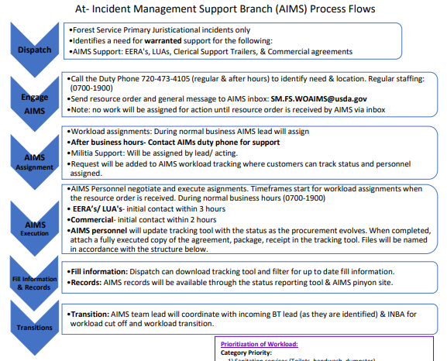
At Incident Management Support (AIMS)
USFS specific incidents
Identified need for EERAs/LUA/Commercial agreements
Available for procurement support T3/4/5 Incidents .
Email: SM.FS.WOAIMS@usda.gov
Notes:
Elka

Slide 9
Incident Procurement/Buying Team Support
Bolstering buying team support
Required training for Buying team members
National Incident Management System, An Introduction (IS-700)
National Response Plan, An Introduction (IS-800)
Introduction to ICS (ICS-100)
Interagency Incident Business Management (S-260)
Reach out to Elka if you would like to participate on a Federal Buying Team
Notes:
Elka

Slide 10
FireNet- Records Management
FireNet will not store Wildland fire incident data on Microsoft Teams and SharePoint indefinitely.
FireNet is considered an authoritative source for incident data during an active incident; however, it is not the “System of Record” for final incident data.
The System of Record is based on official records retention policies, per host agency guidelines and National Archives and Records Administration (NARA) policy. Incident Management Teams (IMTs) should follow instructions given in the delegation of authority, and final authority rests with host agency records retention direction.
As a reminder, FireNet does not recommend using OneDrive. Incident information can be put at risk of accidental deletion if OneDrive is used for syncing between individual OneDrive folders and incident data in SharePoint.
Notes:
Elka

Slide 11
References - Procurement
FS Procurement & Property Service - GPC
http://fsweb.wo.fs.fed.us/pps/pages/gpc/?tab=policy
NWCG Standards for Interagency Incident Business Management https://www.nwcg.gov/sites/default/files/publications/pms902.pdf
http://www.nwcg.gov/pms/pubs/large.html#iibmh
National Buying Team Guide https://www.fs.fed.us/business/incident/static/Interagency%20Buying%20Team%20Guide%20042019.pdf
Forest Service Acquisition Management Incident Internet homepage http://www.fs.fed.us/business/incident/
Forest Service Procurement & Property Services Incident Procurement Intranet homepage
http://fsweb.wo.fs.fed.us/pps/ (click on Incident Procurement, click on Buying Teams)
Region 6 Incident Business Internet homepage
Region 6 - Management (usda.gov)

Slide 12
References – National Incident
NWCG Internet homepage
https://www.nwcg.gov/ (select Committees, List of Committees, and then Incident Business Committee for business information.)
Forest Service Wildland Fire Internet homepage
http://www.fs.fed.us/fire
National Interagency Fire Center (NIFC)
https://www.nifc.gov/
Forest Service Incident Business Practices Internet website
https://www.fs.usda.gov/managing-land/fire/ibp
Interagency Fire Program Management Standard (IFPM)
https://www.fs.usda.gov/managing-land/ifpm
Interagency Standards for Fire and Fire Aviation Operations Guide (Redbook) 2022
https://www.nifc.gov/policies/pol_ref_redbook.html
Notes:
These have been updated; however, I cannot reach them at this time to update.

Slide 13
References – Miscellaneous
Federal Travel Regulation homepage
https://www.gsa.gov/policy-regulations/regulations/federal-travel-regulation-ftr
GSA Global Supply https://www.gsaglobalsupply.gsa.gov/advantage/ws/main/start_page?store=FSS
GSA Advantage
www.gsaadvantage.gov
USDA Advantage
https://usdaadvantage.gsa.gov/advantage/ws/main/start_page?store=USDA
Defense Logistics Agency DLA E-mall (FEDMALL)
https://www.fedmall.mil/index.html

Slide 14
References - Miscellaneous
Procurement Technical Assistance Centers
www.aptac-us.org
NWCG NFES Catalog (Cache Catalog – PMS 449-1)
http://www.nwcg.gov/pms/pubs/catalog.htm
VIPR Incident Blanket Purchase Agreements (I-BPAs) can be found here
http://www.fs.fed.us/business/incident/vipragreements.php
(Search by agreement number, contractor name or Region/Multi-selection criteria)
90% Reports for doing incident-only EERAs
http://www.fs.fed.us/business/incident/viprreports.php
Feeding the Wildland Firefighter publication
http://www.fs.fed.us/t-d/pubs

Slide 15
QUESTIONS ???

